Slide 1
INVESTMENT CASE STUDY SUBMISSION
Group Name:
N.Srinivas & APFE1680024
Naresh Gunjalli & APFE1680664
Abhishek Parikshya & APFE1680840
Pramod Illuri & APFE1680261

Slide 2
<Abstract> What Spark Funds wants to do ?
Spark funds is an investment company who would like to invest 5 to 15mn USD.
They would like to first identify the type of investment they should get into (like Venture, Angel, Seed)
They are interested in identifying English speaking countries which are attracting very high number of investments.
They are also interested to know, which sectors in these countries are attracting most investment.

Slide 3
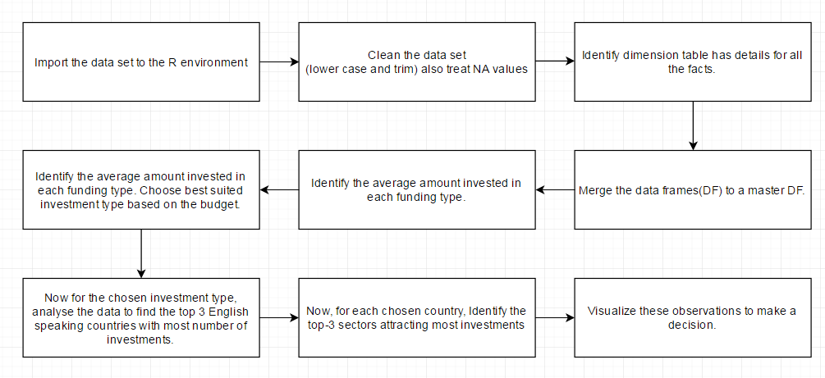
<Problem solving methodology>

Slide 4
<Analysis - Investment type analysis>
Spark funds has a strategy to invest 5 to 15mn USD.
We considered the four funding types for this analysis :
Venture
angel
seed and
private equity
For these funding types, we looked at the average investment amount in the dataset.
This gives a picture of what funding type falls into the budget of Spark funds.
We found that “Venture” type of funding is most suited for Spark funds.

Slide 5
<Analysis – Country Analysis>
Now that we know that we need to concentrate on Venture type of investment data, we move forward with a subset of the venture investment data.
Among these we now find the number of investments that have happened in every country.
We then look into the Top-9 countries to find our countries of interest.
Among these top-9 countries, we choose the top-3 English speaking countries based on the highest number of investments.,
We find that, USA followed by Great Britain and India are the most favourable countries for venture type funding.

Slide 6
<Analysis – Sector analysis>
Now for the Venture type funding in the selected countries (USA, GBR, IND), we would like to identify the top-3 sectors respectively.
So for each country we grouped the number of investments and also the amount invested for each sector.
From this grouping, we identified the top-3 sectors for each country based on the most number of investments.
Below are the final recommendations based on the analysis:

Slide 7
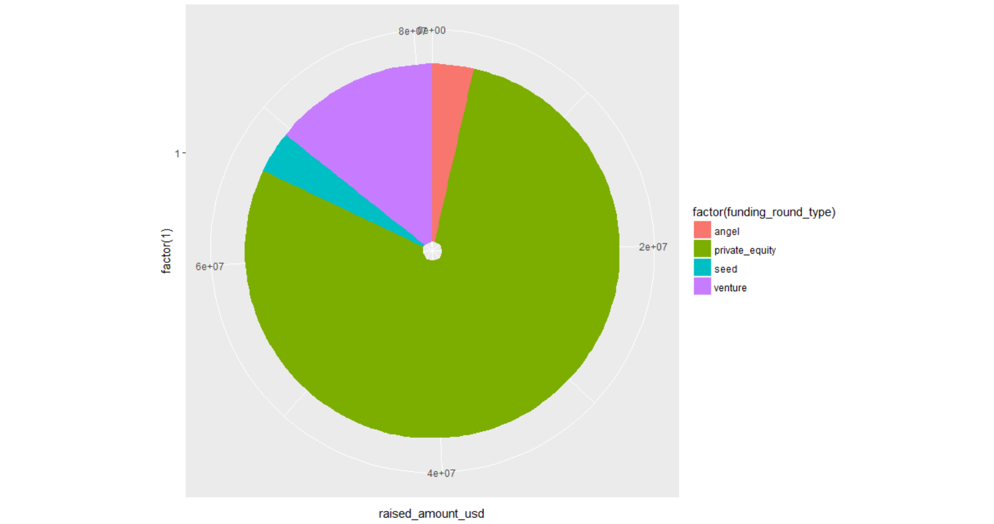
<Amount invested in companies based on funding type>

Slide 8
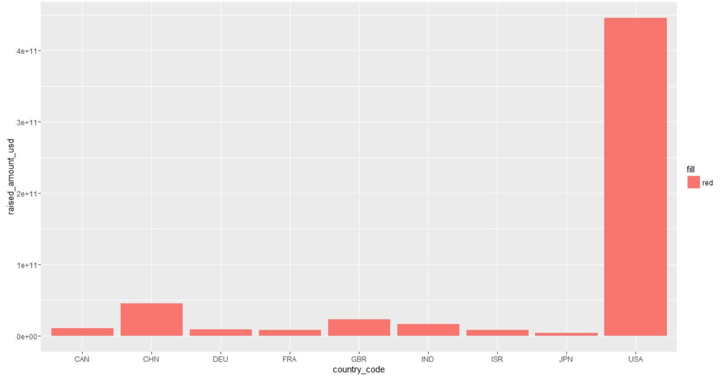
<Total amount invested in top-9 countries for Venture type investments>

Slide 9
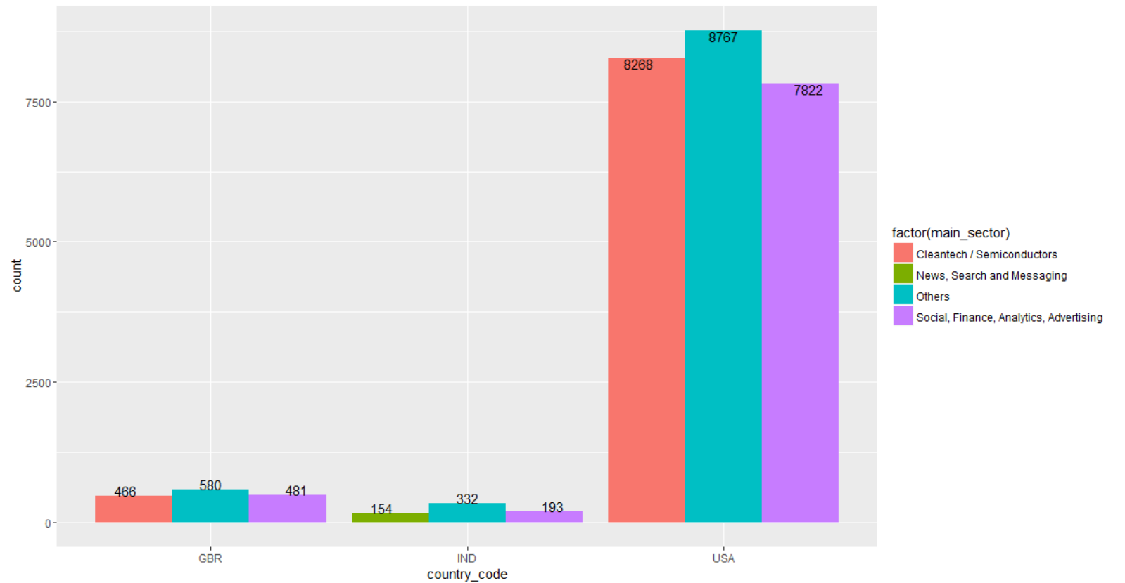
<Total number of investments in top-3 sectors of the top-3 countries>

Slide 10
<Conclusions>
So it is recommended that, Spark funds proceed to do a VENTURE type of investment in the following countries and their respective sectors.

